Slide 1
The Tudor Dynasty
1485-1603

Slide 2
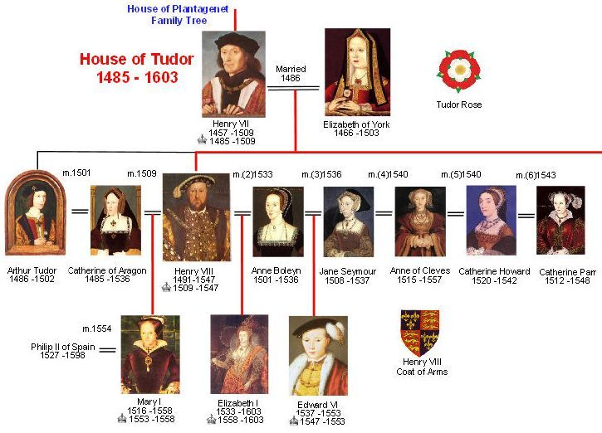

Slide 3
Henry VII (1485-1509)
Henry Tudor married Elizabeth of York (daughter of Edward IV).
Henry had defeated Richard III at the Battle of Bosworth Field, ending the Wars of the Roses.
Henry VII went on to forge international relationships through the marriages of his children.

Slide 4
Henry viii (1509-1547)
Made England a great naval power
Married 6 times
Broke with Catholic Church & started the Church of England
Seized monastery lands & sold to wealthy landowners
House of Commons increased its power during this reign

Slide 5
Edward i (1547-1553)
Only 9 years old when he became king
Was advised by Protestant leaders
Thomas Cranmer, Archbishop of Canterbury
England was in a time of turmoil
Edward died at the age of 15

Slide 6
MARY I (Bloody mary:1553-1558)
Married Philip II of Spain in 1554
Met strong opposition in England
Restored Catholicism in 1555
Had about 300 Protestants burned at the stake for heresy
Involved England in a war with France
England lost the port of Calais

Slide 7
Elizabeth I (1558-1603)
Became queen at the age of 25
Used her authority for the common good of her people
Her reign was one of England’s great cultural periods.
She strongly supported the arts, e.g. the theater and Shakespeare
The English language was transformed into one of beauty, grace, vigor, and clarity

